Slide 1
Week 3: Chapters 5 & 6
Conflict Management (BUS-8419)

Slide 2


Chapter 5: Measuring the Costs of Conflict
In this Discussion:
Measuring the cost and impact of conflict
Undertaking your conflict analysis: A practical guide

Slide 3
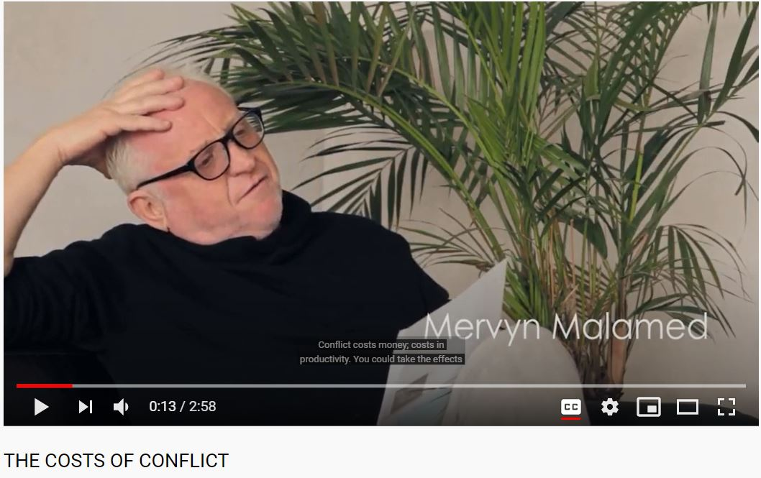
Featured Video:
The Costs of Conflict
https://www.youtube.com/watch?v=xxrB-HmbEw8

Slide 4
Chapter 1: What’s wrong with contemporary conflict management and what organizations do about it?
Let’s Talk about the Video
Identify the costs of conflict. Why are these data on costs of conflict essential in today’s organizations?
https://www.youtube.com/watch?v=xxrB-HmbEw8

Slide 5

Measuring the cost and impact of conflict
“Conflict is not logical; it is irrational. Conflict is not black and white; it is grey. Conflict can be overt or it can be subtle, it can be simple or it can be incredibly complex.”

Slide 6

The Cost of Conflict
The costs of conflict to any business can be great.
There is a growing body of evidence that supports this view but, a lot more work needs to be undertaken to understand the true cost of conflict.

Slide 7


The Cost of Conflict: The Challenges in Gathering Data
Organizations are often resistant to sharing sensitive data
Conflict is complex (academics call it multi-modal) and it is sometimes hard to pin down its exact impact as opposed to other factors at play.
Many organizations do not gather specific data relating to conflict and, thus, many of the costs of conflict are below the horizon, hidden and invisible.

Slide 8

Discussion of Selected Reading 6
Systematic review: Entrepreneurship in conflict and post conflict
Aldairany, S., Omar, R., & Quoquab, F. (2018).
Journal of Entrepreneurship in Emerging Economies

Slide 9
Data Related to Costs of Conflict
According to the joint CIPD/OPP (2008) report:
16 per cent say a recent dispute escalated in duration and/or intensity.
  27 per cent of employees have seen conflict lead to personal attacks.
25 per cent have seen a workplace conflict result in sickness or absence.
9 per cent saw it leads to a project failure.

Slide 10
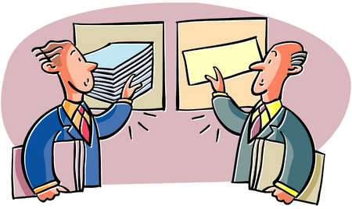
Financial Costs of Conflict
In 2006, UK organizations an eye-watering £33 billion each year
Almost 4 out of 10 (38 per cent) of UK employees had experienced some form of interpersonal conflict in the workplace in the previous year (CIPD, 2015)

Slide 11
The organizational Costs of Conflict
Workplace conflict had a more direct impact on both performance and well-being:
Over a third of managers felt that conflict reduced motivation and productivity.
28 per cent reported that it had a negative impact on decision making.
Almost a third felt that it led to increased health costs or staff absence.
Almost one in five respondents mentioned conflict as having compromised the quality of patient care/experience.

Slide 12
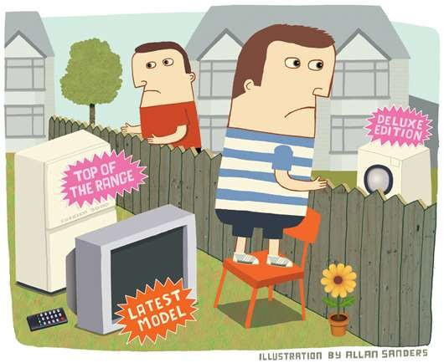
Unresolved conflict as a driver of disengagement
Can have the most significant impact on employee engagement within an organization.
Unresolved conflicts also have an aggregated impact throughout an organization.
Dealing with conflict is hard because it’s messy, there isn’t necessarily a mathematical way of doing it that will result in a particular outcome.

Slide 13
How to Measure Cost and Impact of Conflict
Help organizations to understand the causes and the costs of conflict.
Enable organizations to develop meaningful conflict management strategies.
Help organizations to measure the impact of their conflict management activities.
Support the government and policy makers in developing effective conflict management policies and strategies.
Facilitate benchmarking exercises and the dissemination of best practice.

Slide 14
Building a Business Case for Managing Conflict
More relevant to them and is therefore more meaningful.
More closely aligned to their own situation and context.
A valuable way to secure engagement from a wide and diverse range of organizational stakeholders.
Likely to be taken more seriously by senior decision makers.
A precursor to the development of an integrated conflict management system.
A useful baseline measure for evaluating the impact of any subsequent conflict management strategy or mediation scheme.

Slide 15

Visible Costs on Unresolved Conflict
Time spent – how much time was spent by each person involved.
Opportunity costs – what could they have been doing instead of dealing with the conflict.
Sickness absence.
Turnover – costs of losing good staff.
Cover and hiring costs – costs of covering posts or hiring new staff.

Slide 16
Visible Costs on Unresolved Conflict
Legal fees – the inevitable legal bills that follow a conflict.
Compensation awards – these are applied by the tribunal. Where there is proven discrimination, the awards at an employment tribunal are uncapped.
Delays on project delivery and associated fines and litigation.
Regulator fines and costs – costs applied in cases of conflict that result in regulatory or compliance issues.

Slide 17
Hidden Costs on Unresolved Conflict
Settlement agreements (out of court payments) – these are often confidential but can run into tens if not hundreds of thousands of pounds.
Reduced productivity.
Impact on employee engagement/staff satisfaction.
Impact on customer experience – measured by increased volumes of complaints and reductions in repeat business.

Slide 18

Intangible Costs of Unresolved Conflict
Increased stress, anxiety, depression and other issues relating to mental health
Reduced morale
Presenteeism
Insomnia
Damage to branding and reputation
Damage to employee brand

Slide 19
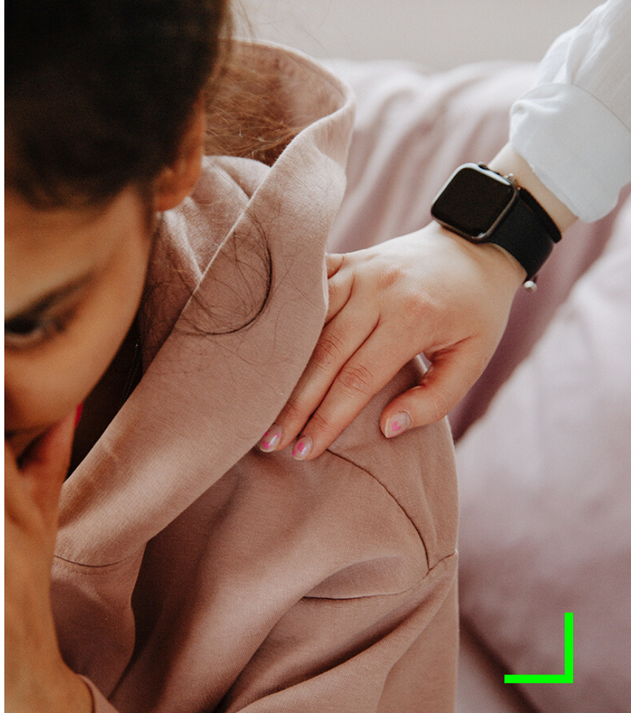
Undertaking Your Conflict Analysis: A Practical Guide
Time spent (including time spent by managers, HR and unions, etc.)
Impact on wellbeing – including stress and absence levels
Attrition levels – losing valued and skilled employees
Reduced employee engagement levels and trust in the workplace
Reduced productivity levels including innovation and motivation

Slide 20

Undertaking Your Conflict Analysis: A Practical Guide
6. Reputational damage.
7. Impact on customer experience.
8. Legal costs – including the cost of lawyers, legal advice and legal representation at proceedings.
9. Settlement agreements, compensation awards, tribunal claims, etc.
10. Overall financial impact on the organization.

Slide 21
Resolution Recommendations
Data that is collected as part of the desktop review may include any of the following:
Grievance levels, including action taken and outcomes.
Bullying and harassment allegations, including action taken and outcomes.
Disciplinary action taken relating to workplace grievances or bullying and harassment allegations.
Data from stress audits or other audits into workplace wellbeing.

Slide 22
Resolution Recommendations
Data that is collected as part of the desktop review may include any of the following:
Allegations and findings of discrimination, including action taken and outcomes.
Employment tribunal levels and outcomes.
Absence data, particularly any data that relates to stress absence or suspensions due to workplace conflicts or allegations of bullying.

Slide 23
Resolution Recommendations
Data that is collected as part of the desktop review may include any of the following:
Employee engagement survey data.
Data gathered from exit interviews.
Data gathered from analysis of whistleblowing cases.
Data gathered from appraisals.
Customer complaints or serious incidents that have arisen as a result of a conflict at work.
Levels of public awareness of conflict in your organization such as press clippings, comments on social media or in the news media.

Slide 24

Chapter 5 Key Learning Points
There are significant costs of conflict to organizations. These may be visible or hidden costs.
Unresolved conflict can have a direct impact on 10 areas of the modern organization.
Organizations benefit by evaluating the costs and impact of conflict as a precursor to developing a conflict management strategy.

Slide 25
Chapter 5 Key Learning Points
The method for undertaking a conflict analysis is based on a participatory action research model.
The costs of conflict are a valuable source of baseline data for use in evaluating the cost-benefit and return on investment of a future conflict management strategy.

Slide 26
References
ACAS (2015) Towards a System of Conflict Management? An evaluation of the impact of workplace mediation at Northumbria Healthcare NHS Foundation Trust, ACAS, London
CIPD (2015) Getting Under the Skin of Workplace Conflict: Tracing the experiences of employees, CIPD, London
CIPD/OPP (2008) Fight, Flight or Face it? Celebrating the effective management of conflict at work, CIPD/OPP, London

Slide 27
Chapter 6: The Psychology of Conflict and Conflict Management
In this Discussion:
Conflict and Loss
Introducing Positive Psychology
The Role of Emotional Intelligence
Maslow’s Hierarchy of Needs

Slide 28
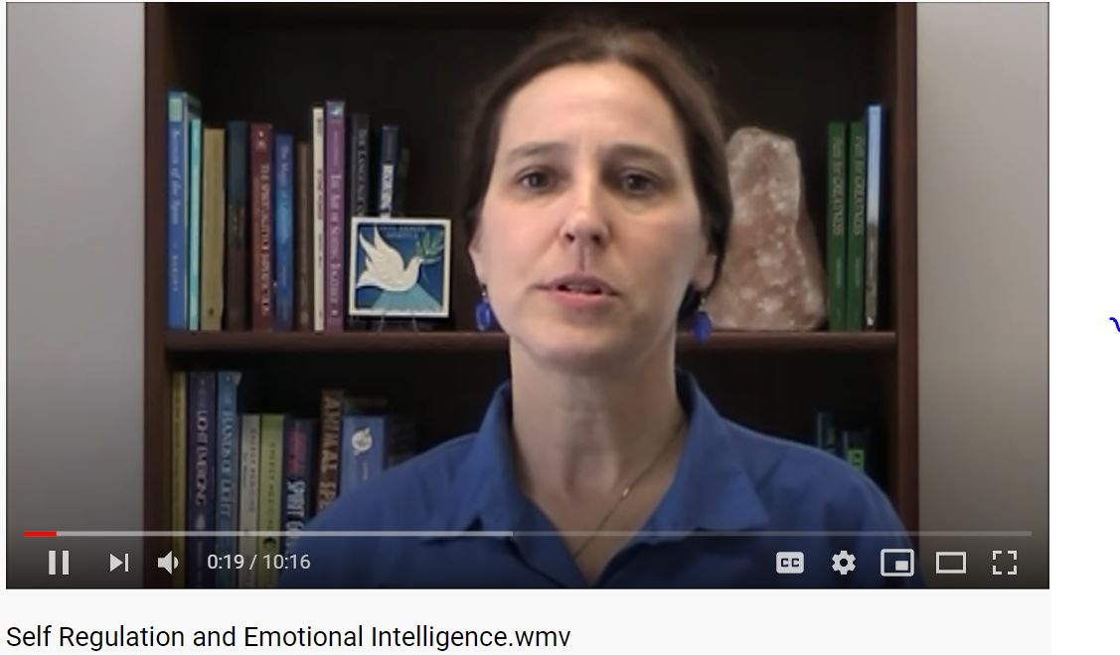
Featured Video:
Self Regulation and Emotional Intelligence
https://www.youtube.com/watch?v=_e5YDCwRuhA

Slide 29
Chapter 1: What’s wrong with contemporary conflict management and what organizations do about it?
Let’s Talk about the Video
Discuss the role that emotional intelligence portrays in resolving conflicts at work.
https://www.youtube.com/watch?v=_e5YDCwRuhA

Slide 30
Conflict and Loss
The stages of grief that Kübler-Ross (1969) described are:
Denial and isolation – a temporary refusal to accept the situation.
Anger – with themselves or with others.
Bargaining – trying to negotiate a different outcome.
Depression – deep feelings of sadness, regret and uncertainty about the future.
Acceptance – the beginning of coming to terms with the loss.

Slide 31
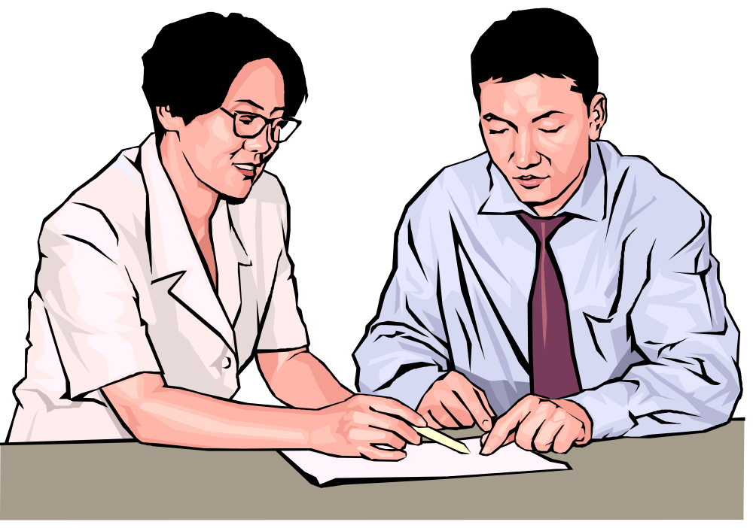
Resolution Reflection
A conflict with your manager
Imagine that you are sat in a weekly briefing meeting with a group of your colleagues and your manager. Your relationship with your manager has been getting increasingly fraught and you find it hard being in the same room as him or her. Your manager says something during the meeting that you find demeaning and overtly critical.

Slide 32

Resolution Reflection
What impact does this have on you?
How do you feel about it?
What happens to your body?
What did you perceive were your manager’s intentions?
How will you respond?
What happens next?

Slide 33
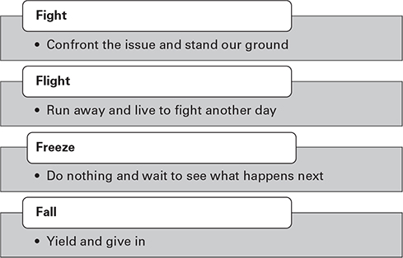
Responses to Conflict

Slide 34

Introducing Positive Psychology
The study of positive aspects of human life, such as happiness, meaning, wellbeing, strength and flourishing.
Scientific study of optimal human functioning [that] aims to discover and promote the factors that allow individuals and communities to thrive (Seligman and Csikszentmihalyi, 2000).

Slide 35

What is flow?
Flow is a state of mind that allows us to accept a new meaning, a surprise or an unexpected change in our lives.
It is similar to mindfulness in as much as it enables us to build confidence and to take control in the present moment.

Slide 36

The mediator’s role is to help the parties to generate and engage in flow
Giving the parties the time and the space to focus entirely on resolving their conflict.
Listening to all sides without blaming or judging them.
Encouraging the parties to describe clearly their needs, goals, hopes and fears, and engage them in dialogue about those.
Speeding up the process or slowing it down based on the topic being discussed and the needs of the parties.

Slide 37

The mediator’s role is to help the parties to generate and engage in flow
Challenging the parties but always remembering that this is their conflict and the resolution needs to be theirs too.
Engaging the parties actively in the process and encouraging them to develop future solutions.
Treating the parties with absolute respect and allowing the parties to express themselves.
The parties control the content of the mediation process at all times.

Slide 38

Selected Reading 7
Emotional intelligence, conflict management styles, and innovation performance: An empirical study
Zhang, S. J., Chen, Y. Q., & Sun, H. (2015)

Slide 39
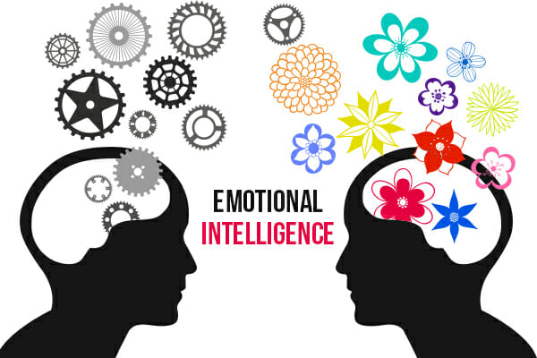
The Role of Emotional Intelligence (EI)
EI can make the parties in conflict feel less threatened and, thus, are less defensive.
EI allows parties to engage in flow, which ultimately leads to a less confrontational dialogue.

Slide 40
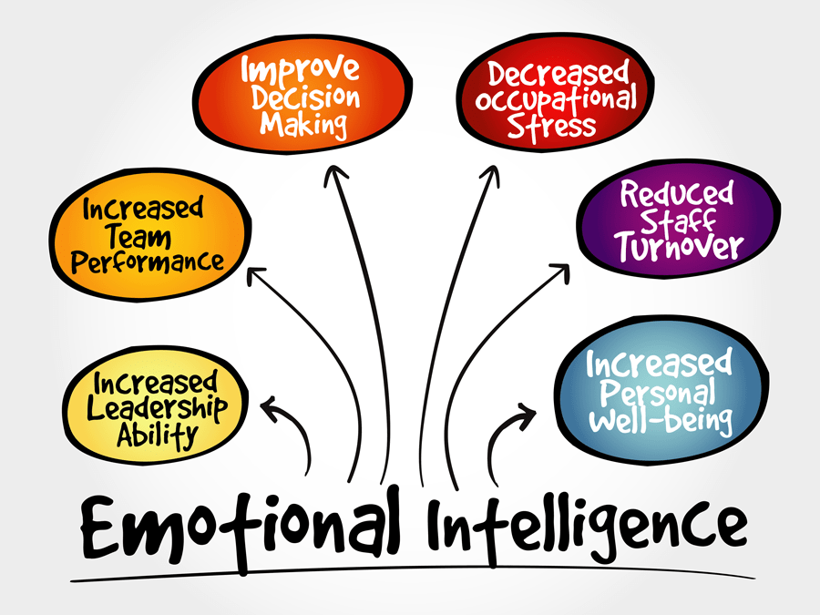
EI is the Ability to:
be self-aware, ie possessing the capacity to recognize, understand and manage one’s own emotions and emotional reactions to situations;
recognize, understand and influence the emotions of others with integrity and compassion;
learn from previous emotionally charged situations/conflicts and to assimilate that learning into positive behavioural change;

Slide 41
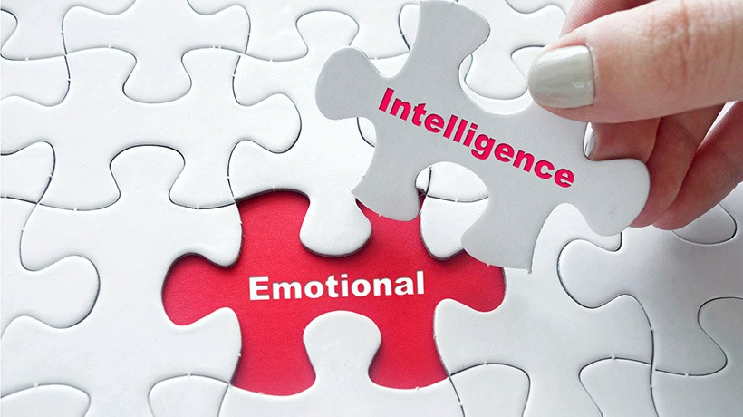
EI is the Ability to:
engage with others constructively and calmly during difficult conversations and during times of change, conflict and crisis;
be empathetic
receive difficult feedback and to respond non-defensively;
anticipate factors or situations that may create an emotional response in others;

Slide 42
EI is the Ability to:
create the conditions for flow and engaging others in adult-to-adult dialogue;
recognize dysfunctional conflict and to transform it into functional conflict;
role model emotional intelligence and develop and value EQ in others.

Slide 43
Integrating EQ Across all Levels of the Organization
Social intelligence – the ability to read and adapt to a variety of social situations. Includes strong communication skills, self-confidence and understanding of social dynamics.
Cultural intelligence – the ability to connect and interact with people across a variety of cultures.
Moral/ethical intelligence – the ability to act with integrity, to take responsibility, to act with compassion and to be willing to forgive others when mistakes are made.

Slide 44
Integrating EQ Across all Levels of the Organization
Spiritual intelligence – to be aware of the greater cause, to be able to act spontaneously to a situation and to be able to step back to see the bigger picture.
Behavioural intelligence – the ability to behave appropriately and the ability to modify those behaviours according to the situation.
Relational intelligence – the ability to understand other people, to relate to them and to collaborate where required. The ability to facilitate the development of relationships between people.

Slide 45
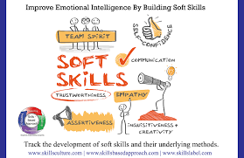
Positive Psychology and EQ in Practice
Integrated in all aspects
Both help in mediation of conflicts

Slide 46
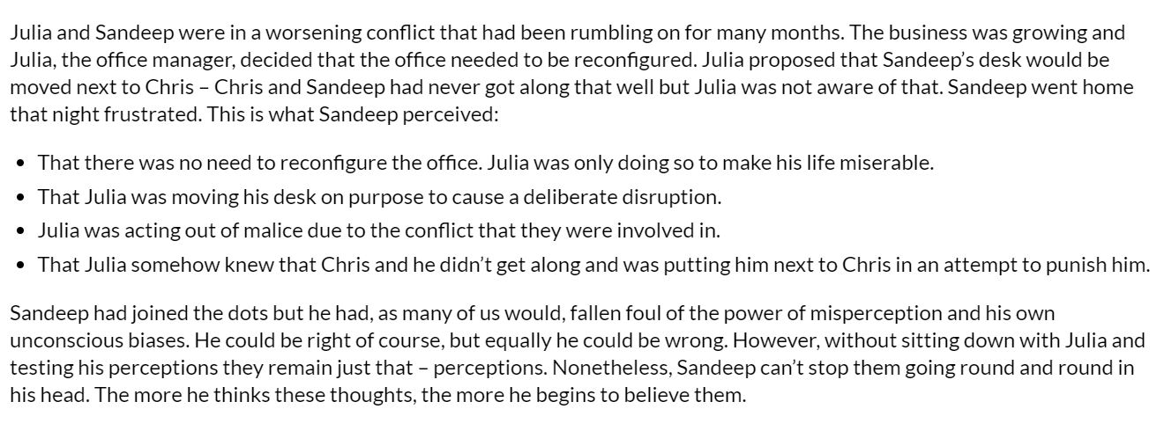
CASE STUDY: Perception and Unconscious Bias

Slide 47

Shared interests and convergent needs – the holy grail of conflict management
Unmet needs are the catalyst for dysfunctional conflict
It is also the catalyst of the resolution of the conflict
During mediation, the parties often explain that they need the same thing – that they have shared interests and convergent (common) needs.
Remember: a want is not a need.

Slide 48
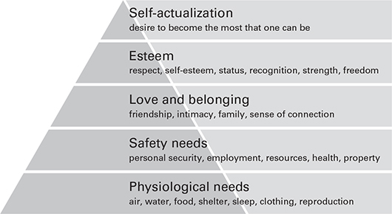
Maslow’s Hierarchy of Needs

Slide 49
Chapter 6 Key Learning Points
Conflict is normal, it is healthy and it is predictable. Conflict can make us stronger and it can enrich our lives – if is handled effectively.
Applying positive psychology enables the parties to explore the positives in their relationship and build on these rather than focusing on the negatives.

Slide 50
Chapter 6 Key Learning Points
The fight or flight response to conflict is powerful but, with courage and willingness, the parties can reject those innate responses in favour of flow.
Flow is a powerful state and it can create meaning and deliver positive change in our lives. Ultimately, resolving a conflict can make us much happier and engaged at work.

Slide 51
Chapter 6 Key Learning Points
Adult-to-adult dialogue is the preferred state and is more effective at resolving disputes than parent-to-child dialogue.
Loss is a powerful driver of negative behaviour during conflict – a loss of control, of face, of esteem. If we can help the parties to make sense of the loss, they can begin to focus on things they can do to transform a loss to a gain.

Slide 52
Chapter 6 Key Learning Points
Putting people in a victim, a rescuer or a persecutor box is restrictive and unhelpful.
Organizations need to reject the drama triangle paradigm that is so explicitly and implicitly embedded within traditional approaches for managing conflict.

Slide 53
References
Boniwell, I (2012) Positive Psychology in Nutshell: The science of happiness, 3rd edn, Oxford University Press, Oxford
Bruk-Lee, V, Ashley E, Nixon, A E and Spector, P E (2013) An expanded typology of conflict at work: Task, relationship and non-task organizational conflict as social stressors, Work & Stress, 27 (4) pp 339–50
Csikszentmihalyi, M (1993) The Evolving Self: A psychology for the third millennium, Harper Perennial, New York
Csikszentmihalyi, M (2008) Flow: The psychology of optimal experience, Harper Perennial Modern Classic, New York
Goleman, G (1996) Emotional Intelligence: Why it can matter more than IQ, Bloomsbury, London
Hodges, J (2016) Managing and Leading People through Organizational Change: The theory and practice of sustaining change through people, Kogan Page, London
Karpman, S (1968) Fairy tales and script drama analysis, Transactional Analysis Bulletin, 26 (7) pp 39–43
Kübler-Ross, E (1969) On Death and Dying, Scribner, New York
Maslow, A H (1943) A Theory of Human Motivation, Psychological Review, 50 (4)
Salovey, P and Mayer, J (1997) Emotional Development and Emotional Intelligence, Basic Books, New York
Seligman, M E P and Csikszentmihalyi, M (2000) Positive psychology: an introduction, American Psychologist, 55, pp 5–14

Slide 54
Readings for Next Class
Resolution spectrum (Chapter 7)
Developing and resolution policy (Chapter 8)
Selected Journal Readings

Slide 55
That’s it. Enjoy reading and participate more.
Thank you!

